Slide 1

SPADE-course 2025 RIVM - Bilthoven
Analysis of SUBGROUPS
by function
f.spade.subgroups

Slide 2
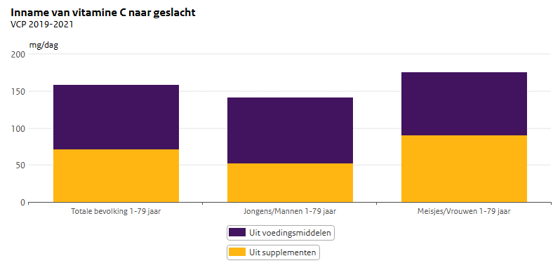
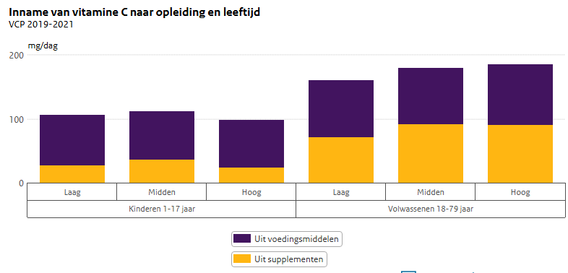
Subgroups
Research questions often target specific subgroups
Examples:
What is the difference in vitamin C intake between men and women?
Do people with a high educational level have a higher vitamin C intake compared to people with a lower educational level?

Slide 3

Analyses by subgroups
What?
With one function, carry out several analyses: e.g. on men and women
Report habitual intakes for total population and subgroups: e.g. Total population / men / women
Sex can be combined with 1 factor variable (with levels): e.g. sex & education level
How?
SPADE carries out an analysis for each subgroup, since e.g. men and women have different intake patterns over age which can not modelled by the same fractional polynomial.

Slide 4
General idea
Pseudo sample
Men
Data
men/women
SPADE splits the data in groups e.g. men / women
for each group
fit the model, e.g. f.spade (1)
construct part pseudo sample (2)
apply mean and percentiles
on total pseudo sample
each subgroup in pseudo sample
id sex age ca wgh
(1) + (2)
(1) + (2)
Women
id sex age ca wgh
Subgroups should not be too small!
Rule of thumb ~50 persons with at least 2 positive intakes

Slide 5
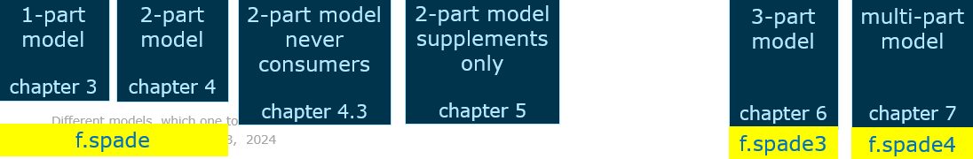
f.spade.subgroups
this function works for
f.spade / f.spade3 / f.spade4
where f.spade4 includes
one or more 1- or 2-part models from different sources, f.spade
one neverconsumers model f.spade.neverconsumers
one supplement model f.spade.supplements
every combination of these 3 models

Slide 6
f.spade.subgroups
two new, extra arguments w.r.t. f.spade
FUN to indicate which function is used
f.spade.subgroups (FUN = f.spade, …)
groups.frml
groups.frml = ~ sex
or
groups.frml = ~ sex + region
different use of 2 existing arguments in f.spade
age.classes
arguments for dietary reference intakes: EAR / AI / UL (DRIs)

Slide 7
Differences for argument age.classes 1/2
f.spade / f.spade3 / f.spade4
only one vector can be defined as an age class
age.classes = c(0, 6, 18, 79)
f.spade.subgroups
a list of age classes can be defined, e.g. age classes for
EFSA dietary reference intakes
national dietary reference intakes
or what ever you need
age.classes = list ( EFSA = c(0, 6, 18, 30, 79), NL = c(0, 6, 12, 18, 30, 59, 79))

Slide 8
Differences for argument age.classes 2/2
f.spade.subgroups( FUN = f.spade, frml.ia = ca ~ fp(age), frml.if = "no.if", data = DNFCSmanual, min.age = 1, max.age = 79, sex.label = "both", groups.frml = ~ sex, age.classes = list ( EFSA = c(0, 6, 18, 30, 79), NL = c(0, 6, 12, 18, 30, 59, 79)), seed = 123456, …)
Consequences for the output
the output files for the analysis don't change
plots original_name_subgroup.pdf
logbooks original_name__logbook.txt
original_name__details.txt
For each age class there is one Excel output file, with the original output name extended:
original_name_EFSA.xlsx
original_name_NL.xlsx
original_name = spadeSUB_BNFCS_ca_sex_only
(automatically generated if output.name = NULL)

Slide 9
Differences for the DRI arguments
f.spade / f.spade3 / f.spade4
Argument for the EAR (men or women) EAR.names - two names of data frames are allowed
Argument for the AI (men or women) AI.names - one name allowed
Argument for the UL (men or women) UL.names - two names of data frames are allowed
Example AI.names = c("EFSA_AI_m", "NL_AI_m") UL.names = c("EFSA_UL_m", "NL_UL_m")
f.spade.subgroups
Instead of 3 → 6 arguments
Instead of vector of names → named list of data sets
The 6 arguments are
EAR.men / AI.men / UL.men EAR.women / AI.women / UL.women
Example AI.men = list(EFSA = EFSA_AI_m, NL = NL_AI_m) AI.women = list(EFSA = EFSA_AI_f, NL = NL_AI_f) UL.men = list(EFSA = EFSA_UL_m, NL = NL_UL_m) UL.women = list(EFSA = EFSA_UL_f, NL = NL_UL_f)
EFSA.AI | EFSA.AI.p | NL.AI | NL.AI.p | EFSA.UL | EFSA.UL.p | NL.UL | NL.UL.p
norm | 0 / 1 | norm | 0 / 1 | norm | percentage > EFSA UL | norm | percentage > NL UL

Slide 10
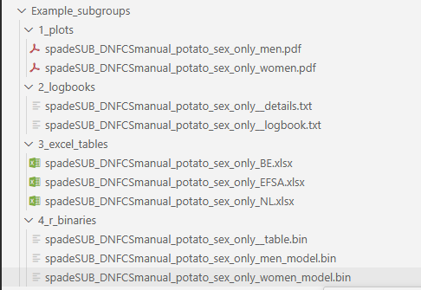
Example f.spade.subgroups
f.spade.subgroups(FUN = f.spade, frml.ia = potato ~ fp(age), frml.if = potato ~ cs(age), data = DNFCSmanual, min.age = 1, max.age = 79, seed = 29062025, groups.frml = ~ sex, weights.name = "w_demog_season_wk_wknd", age.classes = list( BE = c(0, 12, 18, 30, 50, 79), EFSA = c(0, 12, 18, 30, 79), NL = c(0, 6, 12, 18, 30, 79)), spade.output.path = "Example_subgroups")

Slide 11
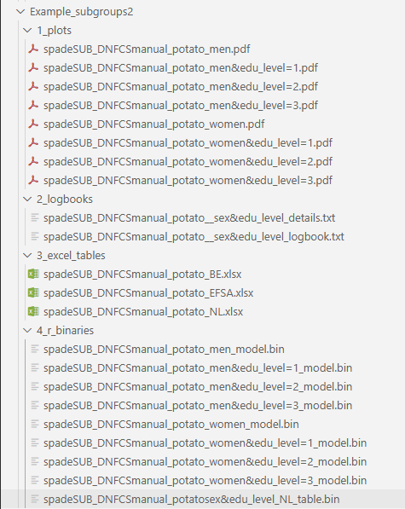
Example f.spade.subgroups
f.spade.subgroups(FUN = f.spade, frml.ia = potato ~ fp(age), frml.if = potato ~ cs(age), data = DNFCSmanual, min.age = 1, max.age = 79, seed = 29062025, groups.frml = ~ sex + edu_level, weights.name = "w_demog_season_wk_wknd", age.classes = list( BE = c(0, 12, 18, 30, 50, 79), EFSA = c(0, 12, 18, 30, 79), NL = c(0, 6, 12, 18, 30, 79)), spade.output.path = "Example_subgroups2")

Slide 12
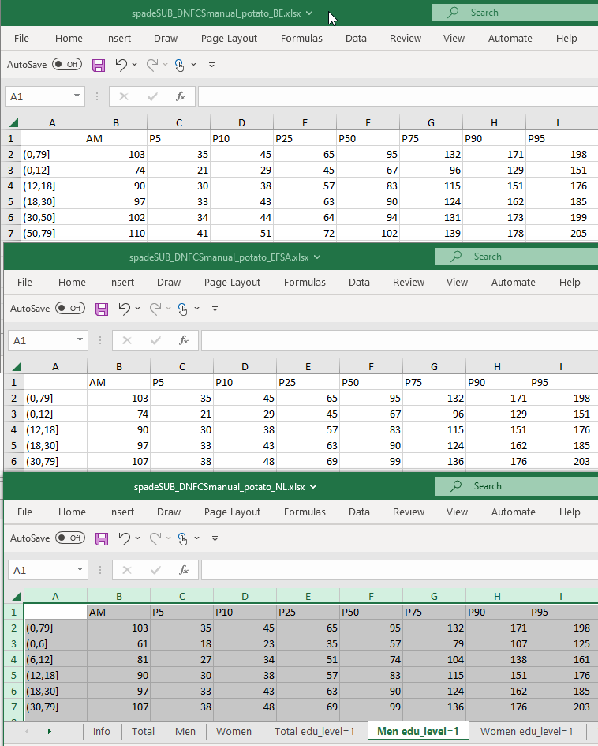
Example output tables Excel output tables
age.classes = list( BE = c(0, 12, 18, 30, 50, 79), EFSA = c(0, 12, 18, 30, 79), NL = c(0, 6, 12, 18, 30, 79)),
spadeSUB_DNFCSmanual_potato_BE.xlsx
spadeSUB_DNFCSmanual_potato_EFSA.xlsx
spadeSUB_DNFCSmanual_potato_NL.xlsx
Warning: the results for men are the same for f.spade and f.spade.subgroups but not for the other subgroups. This is caused by the random number generator which uses only for men the same seed, and then continues in f.spade.subgroups.

Slide 13
Excercise 1
Run f.spade.subgroups to calcium intakes. For subgroups, use sex and education level. How many Habitual Intakes tables do you expect?
What is the difference in calcium intake (mean and median) of adult men and adult women? Use weight factor w_demog_season_wk_wknd and seed = 29062025.
What is the difference in % below the EAR?
Is the % below the EAR different for women aged 50-79 with a higher education level (edu_level=3) compared to women aged 50-79 with a lower education level (edu_level=1)? If yes, what is the difference? And for the men aged 50-79?

Slide 14
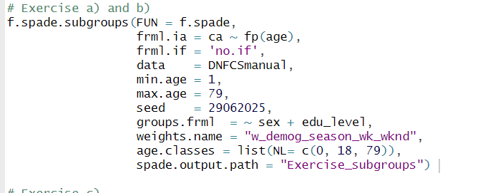
Solutions

Slide 15
Solutions
You will Habitual intakes for each of the 12 (sub)groups:
Total
Men
Women
Total edu_level=1
Men edu_level=1
Women edu_level=1
Total edu_level=2
Men edu_level=2
Women edu_level=2
Total edu_level=3
Men edu_level=3
Women edu_level=3

Slide 16
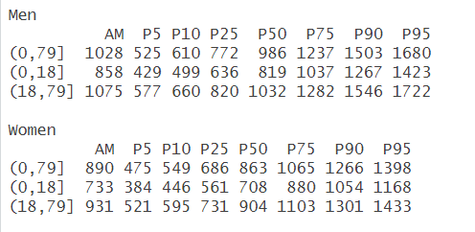







b)

Slide 17
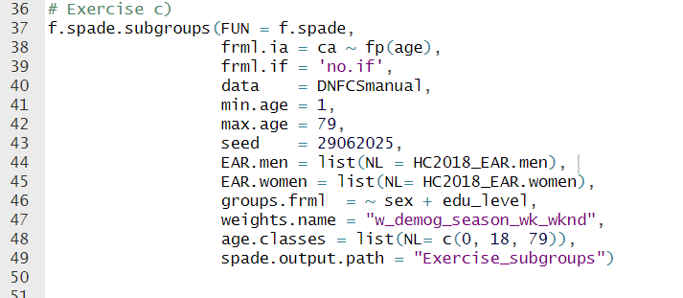

Solutions

Slide 18
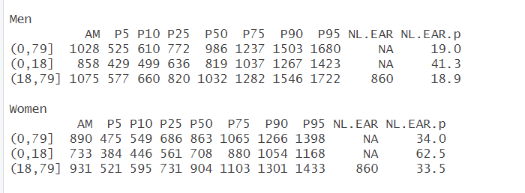


Solutions
c)

Slide 19
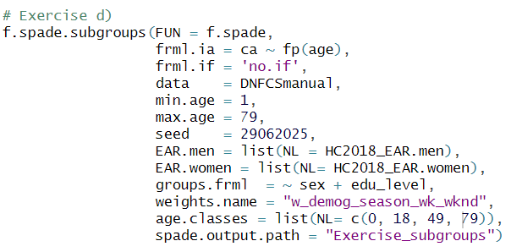
Solutions

Slide 20
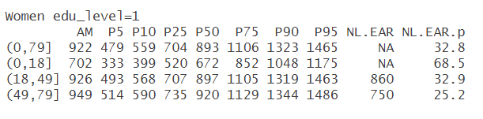
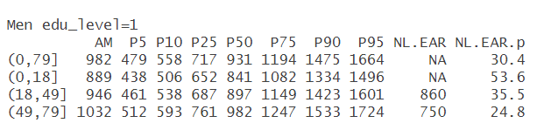
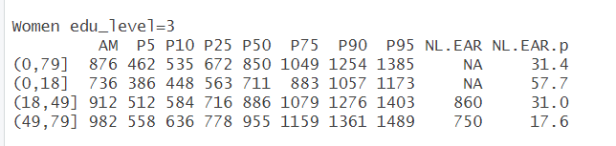
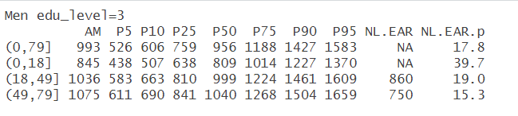




d)

